Slide 1
Problem on Law of Inclusion Exclusion
Question:
Among 50 patients admitted to a hospital, 25 are diagnosed with pneumonia, 30 with bronchitis, and 10 with both pneumonia and bronchitis. Determine:
(a) The number of patients diagnosed with pneumonia or bronchitis (or both).
(b) The number of patients not diagnosed with pneumonia or bronchitis.

Slide 2
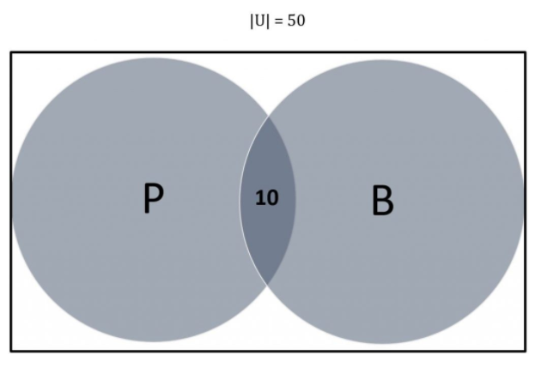
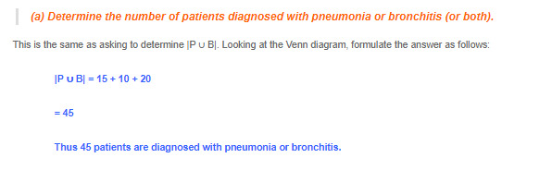
Solution
Let U denote the entire set of patients. Let P and B denote the set of patients diagnosed with pneumonia and bronchitis respectively. Thus:
|U| = 50
|P| = 25
|B| = 30
|P ∩ B| = 10

Slide 3
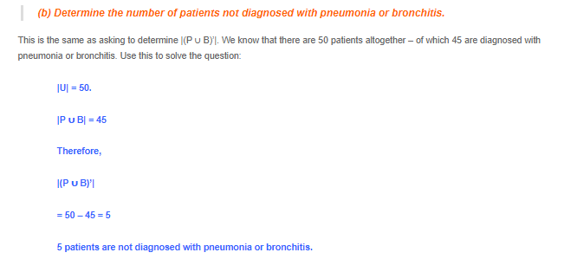
The same answer can also be reached by using the inclusion-exclusion principle directly without referring to the Venn diagram:
|P ∪ B| = |P| + |B| – |P ∩ B|
= (25 + 30) – (10)
= 45
Thus 45 patients are diagnosed with pneumonia or bronchitis.

Slide 4
Question:
A large software development company employs 100 computer programmers. Of them, 45 are proficient in Java, 30 in C#, 20 in Python, six in C# and Java, one in Java and Python, five in C# and Python, and just one programmer is proficient in all three languages above.
Determine the number of computer programmers that are not proficient in any of these three languages.
Let U denote the set of all employed computer programmers and let J, C and P denote the set of programmers proficient in Java, C# and Python, respectively. Thus:
|U| = 100
|J| = 45
|C| = 30
|P| = 20
|J ∩ C| = 6
|J ∩ P| = 1
|C ∩ P| = 5
|J ∩ C ∩ P| = 1

Slide 5
First of all, we need to calculate JUCUP then (JUCUP)’
(JUCUP) = |J| U |C| U |P| - (|(J∩ C)|+ |(J∩ P)|+ |(C∩ P)|)+|J∩ P∩ C|
(JUCUP) = 45+30+20 - (6 + 1 + 5) + 1 = 84
(JUCUP)’ = 100-84 = 16, programmers are not proficient in any language

Slide 6
Functions
Section 2.3

Slide 7
Section Summary
Definition of a Function.
Domain, Codomain
Image, Pre image
Injection, Surjection, Bijection
Inverse Function
Function Composition
Graphing Functions
Floor, Ceiling, Factorial

Slide 8
Functions
Definition: Let A and B be nonempty sets. A function f from A to B, denoted f: A → B is an assignment of each element of A to exactly one element of B. We write f(a) = b if b is the unique element of B assigned by the function f to the element a of A.
Functions are sometimes
called mappings or
transformations.
Students
Grades
A
Carlota Rodriguez
B
Sandeep Patel
C
Jalen Williams
D
F
Kathy Scott

Slide 9
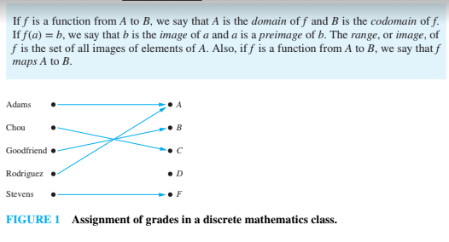

Slide 10
Functions
A function f: A → B can also be defined as a subset of A×B (a relation). This subset is restricted to be a relation where no two elements of the relation have the same first element.
Specifically, a function f from A to B contains one, and only one ordered pair (a, b) for every element a∈ A.
and

Slide 11
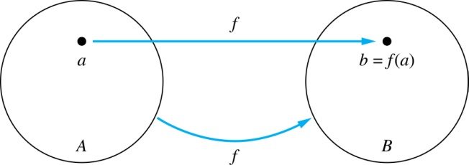
Functions
Given a function f: A → B:
We say f maps A to B or
f is a mapping from A to B.
A is called the domain of f.
B is called the codomain of f.
If f(a) = b,
then b is called the image of a under f.
a is called the preimage of b.
The range of f is the set of all images of points in A under f. We denote it by f(A).
Two functions are equal when they have the same domain, the same codomain and map each element of the domain to the same element of the codomain.

Slide 12
Equal Functions
Two functions are equal when they
have the same domain,
have the same codomain,
map each element of their common domain to the same element in their common codomain.
If we change either the domain or the codomain of a function, then we obtain a different function.
If we change the mapping of elements, then we also obtain a different function.

Slide 13
Representing Functions
Functions may be specified in different ways:
An explicit statement of the assignment.
Students and grades example.
A formula.
f(x) = x + 1
A computer program.
A Java program that when given an integer n, produces the nth Fibonacci Number (covered in the next section and also inChapter 5).

Slide 14
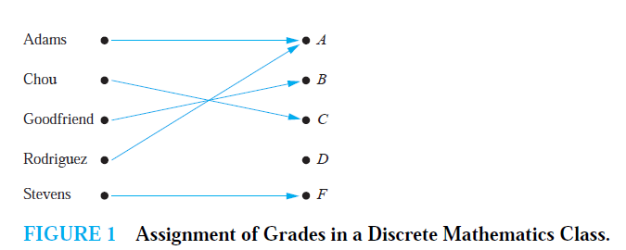
Activity Time
What are the domain, codomain, and range of the following function

Slide 15
Solution
Let G be the function that assigns a grade to a student in our discrete mathematics class.
Note that G(Adams) = A, for instance.
The domain of G is the set {Adams, Chou, Goodfriend, Rodriguez, Stevens},
The codomain is the set {A,B,C,D,F}.
The range of G is the set {A,B,C, F},

Slide 16
Questions
z
A
B
f(a) = ?
The image of d is ?
z
a
x
The domain of f is ?
A
b
y
The codomain of f is ?
B
c
d
z
The preimage of y is ?
b
f(A) = ?
The preimage(s) of z is (are) ?
{a,c,d}

Slide 17


Question on Functions and Sets
If and S is a subset of A, then
A
B
f {a,b,c,} is ?
{y,z}
a
x
f {c,d} is ?
b
{z}
y
c
d
z

Slide 18

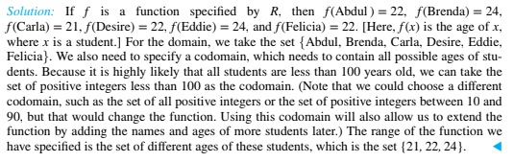

Slide 19
Injections
Definition: A function f is said to be one-to-one , or injective, if and only if f(a) = f(b) implies that a = b for all a and b in the domain of f. A function is said to be an injection if it is one-to-one.
A
B
a
x
v
b
y
c
z
d
w

Slide 20


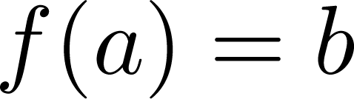
Surjections
Definition: A function f from A to B is called onto or surjective, if and only if for every element there is an element with . A function f is called a surjection if it is onto.
A
B
a
x
b
y
c
z
d

Slide 21
Bijections
Definition: A function f is a one-to-one correspondence, or a bijection, if it is both one-to-one and onto (surjective and injective).
A
B
a
x
b
y
c
d
z
w

Slide 22
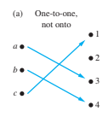
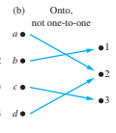
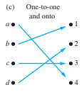
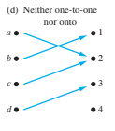
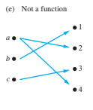

Slide 23



